Slide 1



JANUARY 2018
1 | 2 | 3 | 4 | 5 | 6 | 7
8 Roberta Moore | 9 | 10 | 11 Patrick Fischer | 12 | 13 Matthew Norberg | 14 Lan Utsey
15 | 16 | 17 | 18 | 19 | 20 | 21
22 | 23 | 24 | 25 | 26 | 27 | 28
29 | 30 | 31

Slide 2

FEBRUARY
 |  |  | 1 | 2 Tamikial Green | 3 | 4
5 | 6 Antraun Williams Joseph Luzich | 7 | 8 Margaret Fenske | 9 | 10 Tyonna Lucas | 11
12 | 13 Andria Miranda | 14 | 15 | 16 Krystal Williams Victoria Magnusson | 17 | 18
19 | 20 | 21 | 22 | 23 | 24 | 25
26 Vernell Smith | 27 | 28

Slide 3

MARCH
 |  |  | 1 | 2 | 3 | 4
5 | 6 | 7 | 8 | 9 | 10 | 11
12 | 13 Lana Love | 14 | 15 | 16 | 17 | 18
19 | 20 | 21 | 22 | 23 | 24 | 25
26 | 27 | 28 | 29 | 30 | 31

Slide 4



APRIL
 |  |  |  |  |  | 1 Thomas Ehrhardt
2 | 3 Ana Ayala | 4 | 5 | 6 | 7 | 8
9 Krystal Williams | 10 William Jackson | 11 | 12 Shehzaad Bhamia | 13 | 14 | 15 Easter Egg Hunt To Be Announced Easter Potluck 11-3
16 | 17 Danielle Conway | 18 | 19 Matthew Kraemer Debra Hansing | 20 | 21 | 22
23 | 24 Michael Cordona Jordyn Sukalski | 25 Alton Jones | 26 Justina Medina | 27 | 28 Niyimbona Fadhili | 29 Johnny Pipkins
30 Patricia Felchner

Slide 5

MAY
 | 1 Neil Tuffey Irma Easter Gina Seay-Williams | 2 | 3 | 4 | 5 | 6
7 | 8 | 9 Francisco Segura | 10 | 11 | 12 | 13
14 | 15 | 16 Jazzmen Purnell | 17 | 18 Anton Impastato | 19 | 20
21 | 22 Ramiro Jaramillo | 23 Victoria Minshall | 24 | 25 | 26 Daniel Strommen | 27
28 Niyimbona Fadhili | 29 Michael Cordona | 30 | 31

Slide 6

JUNE
 |  |  |  | 1 | 2 | 3 Heather Wetzel
4 Elisabeth Solis | 5 | 6 | 7 Robert Abutin Melissa Milkie | 8 Shehzaad Bhamla | 9 | 10
11 | 12 | 13 Jazzmen Purnell | 14 | 15 Anton Impastato | 16 | 17
18 Happy Father’s Day Matthew Norberg | 19 | 20 Tereasa Feltz Edward Mydy | 21 | 22 Samantha Lucht Edward Mydy | 23 Daniel Strommen | 24
25 Niyimbona Fadhili William Jackson Sarah Zawiowski | 26 Eyleen Olivares Cheyenne Preston | 27 | 28 Carol Zalewski | 29 | 30 Joseph Cook

Slide 7

JULY
 |  |  |  |  |  | 1
2 Danielle Conway | 3 June Gauthier | 4 Emmett Wooten | 5 | 6 | 7 Michele Tocco Valary Mueller | 8
9 | 10 | 11 | 12 | 13 | 14 Alton Jones | 15 April Conway
16 Nicole Schroeder | 17 | 18 | 19 | 20 | 21 Sharla Morey Indasia Shareef | 22 Anthony Greer
23 | 24 | 25 Bobby Watson | 26 Roberta Moore | 27 William Jackson | 28 | 29
30 Say Yeng Xiong | 31

Slide 8

AUGUST
 |  | 1 Joseph Kraemer | 2 Tereasa Feltz | 3 | 4 | 5
6 | 7 | 8 | 9 Leandra Kallas Divine Spann | 10 Debra Hansing Leandra Kallas | 11 Tina Alexander | 12
13 | 14 | 15 Tana Rucinski | 16 | 17 | 18 Emmett Wooten | 19 Jon Glazer
20 | 21 | 22 | 23 | 24 | 25 | 26
27 Joshua Kiefer | 28 | 29 | 30 June Gauthier | 31 Niyimbona Fadhili

Slide 9

SEPTEMBER
 |  |  |  |  | 1 | 2
3 | 4 | 5 | 6 James Smith Latina Stewart | 7 | 8 | 9
10 | 11 | 12 | 13 Francisco Segura | 14 | 15 | 16
17 | 18 | 19 Xiomara Nunez | 20 | 21 Jordyn Szukalski | 22 Anita Wood | 23 Justina Medina
24 | 25 | 26 | 27 | 28 | 29 Joseph Kraemer | 30

Slide 10

OCTOBER
1 | 2 | 3 | 4 | 5 | 6 | 7 Jeanette Chatman
8 | 9 | 10 | 11 | 12 | 13 | 14
15 | 16 | 17 | 18 | 19 | 20 | 21
22 | 23 Magdalena Calderon | 24 | 25 | 26 | 27 | 28
29 | 30 | 31

Slide 11

NOVEMBER
 |  | 1 | 2 Carol Zalewski | 3 | 4 | 5
6 Justina Medina | 7 | 8 | 9 | 10 Isaiah Baisden | 11 | 12
13 | 14 Judy Sweetman | 15 Donna Biba | 16 Shiela Hernandez | 17 | 18 | 19 Indasia Shareef
20 | 21 | 22 | 23 | 24 Jon Glazer | 25 | 26 James Stolowski Bessie Hughes
27 | 28 | 29 | 30 Cindy Calderon

Slide 12

DECEMBER
 |  |  |  | 1 | 2 | 3
4 | 5 | 6 | 7 Sarah Zawikowski | 8 | 9 | 10
11 | 12 | 13 | 14 | 15 | 16 | 17 Bobby Watson Rodolfo Calderon
18 | 19 | 20 | 21 | 22 | 23 | 24
25 | 26 | 27 | 28 | 29 | 30 | 31

Slide 13

Check out our scores for
Look what our customers are saying about their shopping experience!
C
1ST
T
E

Slide 14

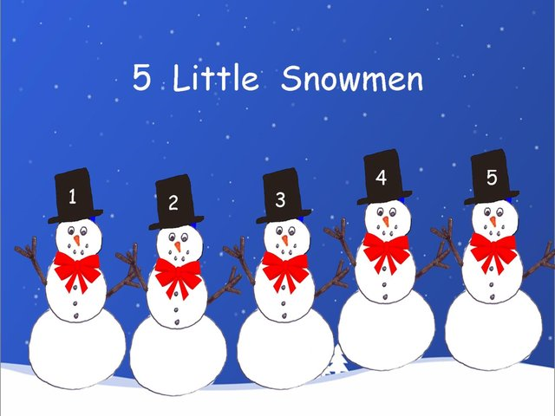
Check out our scores for
E
C
1ST
T

Slide 15
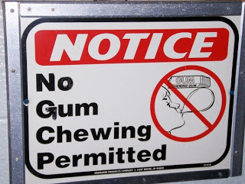
Remember, No chewing gum on the sales floor.

Slide 16
Dress Code For Summer
Black Slacks with a Belt (no Jeans, shorts, capris, or leggings)
Black Shoes
Black Socks
Green Polo Shirt
Your Name Tag
Appropriate Cap and Apron For Departments (Produce, Bakery, Meat, Deli)

Slide 17
GOALS

Slide 18
OUR STATS

Slide 19
How Do We Stack Up?

Slide 20
Our stats over the last four weeks

Slide 21
The Big Four
Date Updated: Friday, March 31, 2017

