Slide 1
Winnie the Pooh Baby Quilt
Disappearing 9-patch

Slide 2
Supplies for a Crib Sized Quilt
Measures: 30 inches wide and 47 inches long
Materials for Quilt:
1 Yard – Pooh Bee Cuddly Dot Toss Flannel (Available at fabrics.com)
½ yard – Blue Camouflage Flannel ((available at Joann’s Fabric)
1/8 yard – Solid Blue Flannel (available anywhere)
½ yard – Snuggle Flannel Fabric Celestial Sky On Blue (available at Joann’s Fabric)
1 yard – Disney’s Winnie the Pooh Fleece Multi (Available at fabrics.com)
36 by 55 inch Cotton Batting
Thread for sewing seams
Blue Mettler Thread
Yellow Mettler Thread
Pink Mettler Thread
Orange Mettler Thread
Standard Quilting Supplies:
Rotary cutter
Cutting Mat
Iron and Iron Mat
Square ruler (used to center pooh characters)
6 ½ by 24 inch ruler

Slide 3
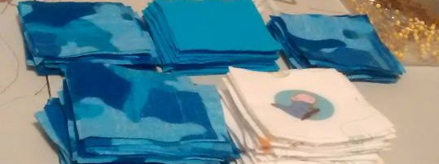
Step 1
Cutting Out the Quilt
Cut out 66 – three inch squares of Blue Camouflage Flannel
Cut out 17 – Three inch squares of Eeyore (centering the character)
Cut out 17 – Three inch squares of Winnie the Pooh (centering the character)
Cut out 16 – Three inch squares of Eeyore (centering the character)
Cut out 16 – Three inch squares of Eeyore (centering the character)
Cut out 33 – three inch squares of Solid Blue Flannel
Cut out 17 – 1 ½ inch squares of Blue Camouflage Flannel
Cut out 18 – 1 ½ inch squares of Solid Blue Flannel
Cut out 1 - 1 ½” solid blue Flannel Square
Cut out 2 - 1 ½” by 3” strip Blue Camouflage flannel

Slide 4
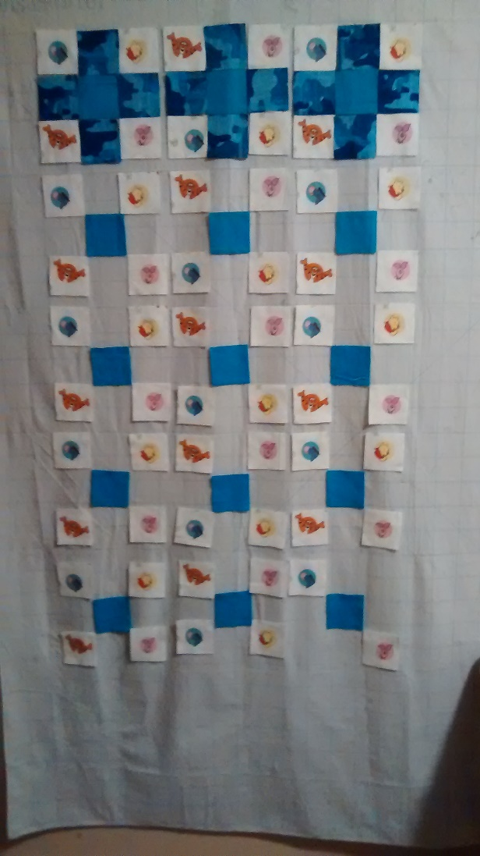
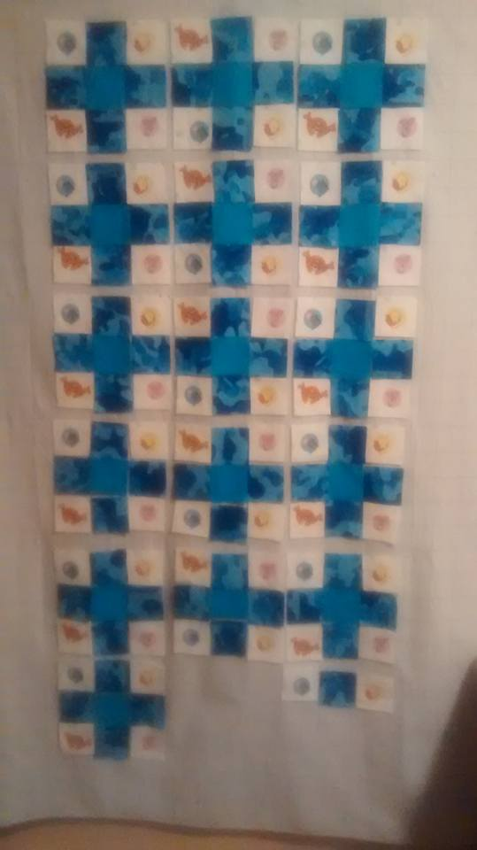
Step 2
Layout 9-Patch Quilt
Place a 3” Eeyore Square in the first spot on the top row
Place a 3” Camouflage in the second spot on the top row
Place a 3” Winnie the Pooh in the third spot on the top row
Place a 3” Camouflage in the first spot on the middle row
Place a 3” Solid Blue in the second spot on the middle row
Place a 3” Camouflage in the third spot on the middle row
Place a 3” Tigger square in the first spot on the bottom row
Place a 3” Camouflage in the second spot on the bottom row
Place a 3” Piglet square in the last spot on the bottom row
Repeat for all the squares
* Note: the last 3 squares will be set aside for later

Slide 5
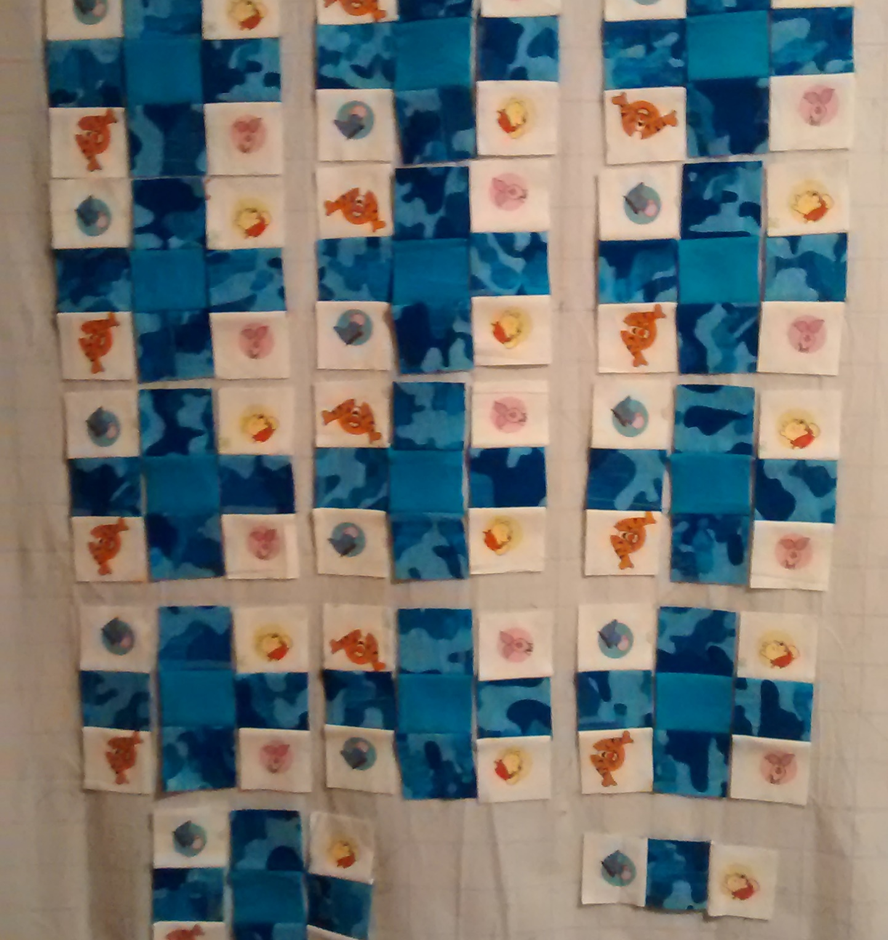
Step 3
Layout 9-Patch Quilt Layout
Flip the upper left corner character squares to face down
Flip the right corner character squares to face left
Flip the lower left corner character squares to the right
Keep the lower right corner character squares upright
* See picture for layout
* Note last three squares on the bottom row will be done in a separate step

Slide 6
Step 4
Stack your squares carefully
Remove the top row of Winnie the Pooh characters from left to right
Remove the second row of Winnie the Pooh characters from left to right
Remove the third row of Winnie the Pooh characters from left to right
Remove the fourth row of Winnie the Pooh characters from left to right
Remove the fifth row of Winnie the Pooh characters from left to right
Remove the last 3 Winnie the Pooh characters from left to right
Remove the camouflage blue squares from top row, repeating for each 9 patch
Remove the solid blue squares from top row, repeating for each 9 patch
Remove the camouflage blue squares from bottom row, repeating for each 9 patch
Remove the middle row camouflage squares from all 9 patch squares.
Stack all the 9 patches up with tops up
* Note be careful to leave the Winnie the Pooh characters flipped the direction as on the layout board. Example the first one should be flipped downward. Make sure you put the squares top at the top to avoid upside characters.

Slide 7
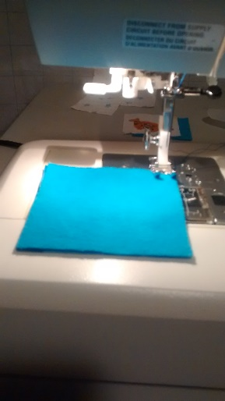
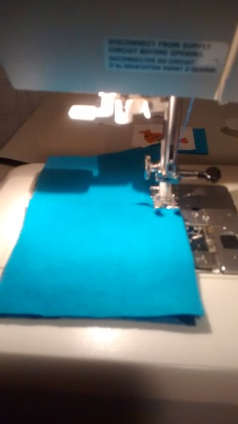
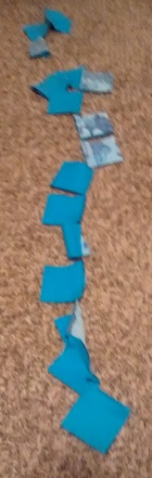
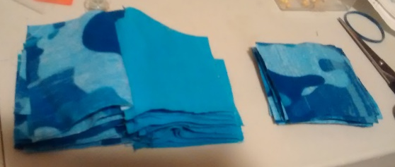
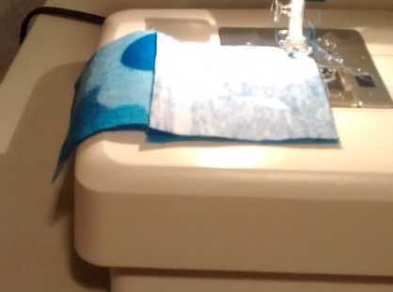
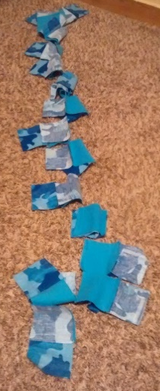
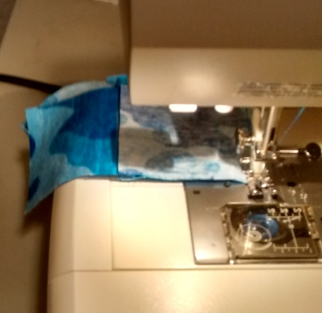
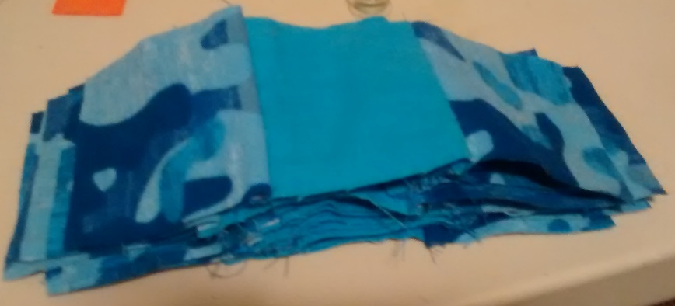
Step 5
Time to Sew our 9 Patches
Middle Rows will be easiest to sew
First sew the camouflage to a solid blue square
Chain sew the top to the middle
Cut the thread in your chain
Open the sewn squares with camouflage on left
Then sew the bottom camouflage to the solid square
Chain sew the bottom camouflages to solids
Cut apart the chain
You will then have all the middle rows done
Place them on you layout boards (makes the middle row of 9 patch).
A. Camo and Blue solid squares
B. Chain sew the top to the middle
C. Finished chain
D.
Open sewn squares
F.
Sew the bottom camouflage on the solid
H. Cut Apart the chain
I. Open up your blocks. All center rows are done.
G. Chain sew the bottom camouflages to solids

Slide 8
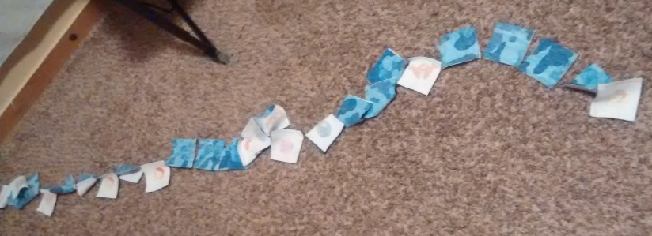
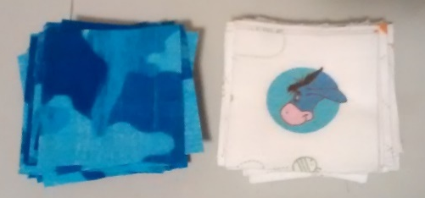
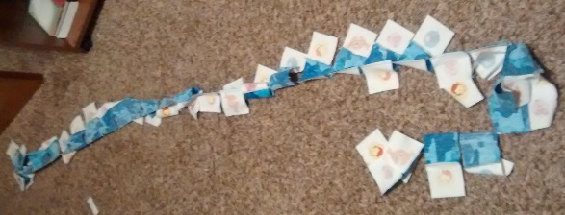
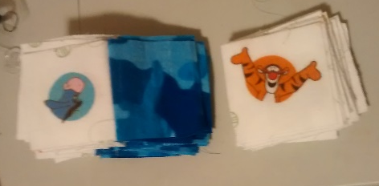
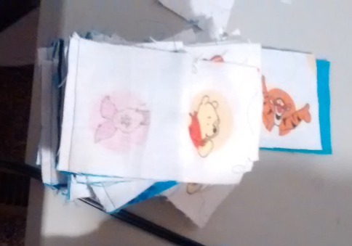
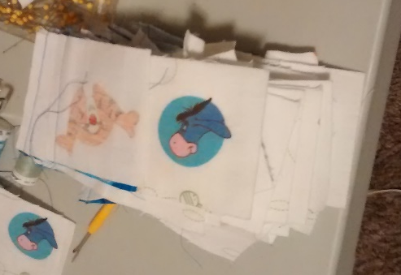
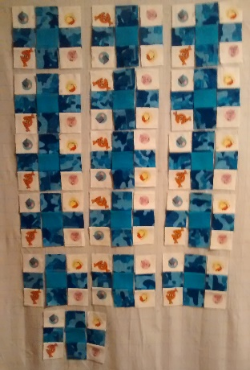

Step 6
Sewing the character squares
Placement is very important
Make sure the bottom edge is to the top edge, sew Winnie the Pooh characters to camouflage squares
Chain sew all squares until you run out
Cut chain, keeping them in the correct order
Make sure the top edge is facing the bottom edge of camouflage
Cut Chain apart, make sure to keep in order from 1st to last row *pictures E1 – E3
Place all squares on layout board. Making sure to place 1st row on left to the last row on bottom.
*If you chain stitched them the first one should be on top to last one on bottom. Layout is very important to guarantee they will be the correct direction.
A. Make sure bottom edge of Winnie the Pooh characters face the sewing edge.
B. Chain sew all squares.
C. Cut chain from top to bottom, keeping them in correct order
D. Make sure the top edge of Winnie the Pooh characters faces bottom edge of camouflage sets
E1 Cut apart carefully from first to last rows.
F1 This is my stack to layout my squares again. I flipped the character rows so my first was on top ←--
F2. This is how the rows will look when finished with this step. -→
E2-E3 I placed my first row down when cutting and turned them upside down. This guaranteed that I had the first row on top when I flipped them over. Start placing them on board one row on each side of Camo/solid rows.

Slide 9
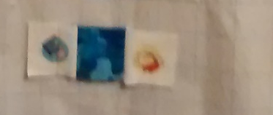
Step 7
Dealing with the last two character squares.
Sew the first character squares to the camouflage square
Sew the last character square to the camouflage square
Sew 1 camouflage 3” by 1 ½” strip to the solid 3” by 1 ½”
Sew she the 2nd camouflage 3” by 3” by 1 ½” strip to the first two
Pin the camouflage/Blue row with the character row. Making sure the bottom of character row is sewn to the top of camouflage row.
Note: be careful to leave the characters in the correct directions. The first one should face down and the last one should face left. You can also use 3” by 3” squares and cut them down later. I forgot to take a picture of the finished square.

Slide 10
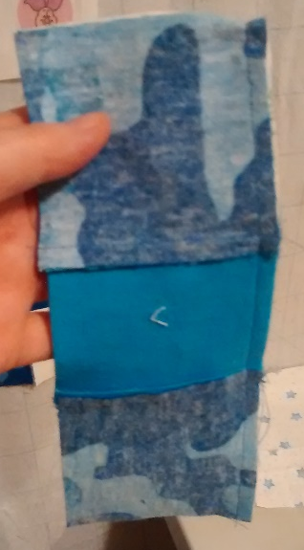
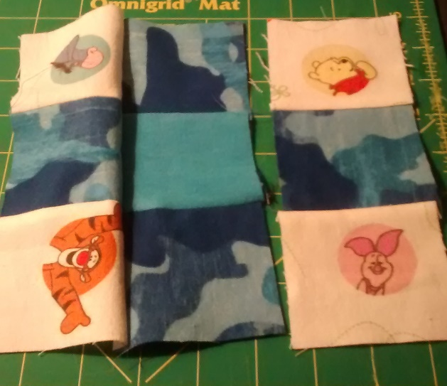
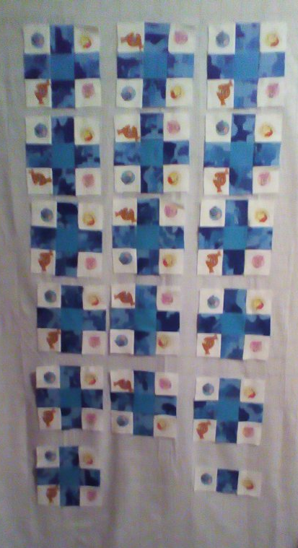
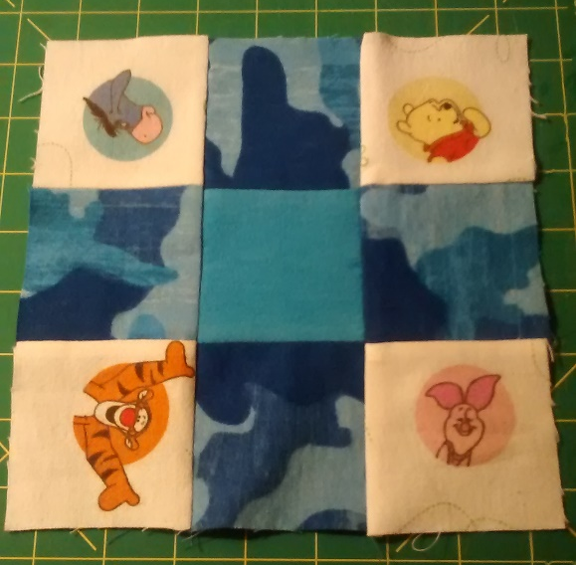
Step 8
9-Patch Assembly
Working from Left to right.
Press all character rows towards the characters
Press all center rows towards the solids
Remove 1st rows from all squares
Remove center rows from all squares
Remove 3rd rows from all squares
Sew 1st row to center row
Sew 1st & 2nd Row set to 3rd row
Press all squares towards the pictures
Put squares back on Layout board
F. Sew center to 1st row making sure match the seams and the right edge to the left edge.
G. Sew the3rd row to the center row. Matching up the seams.
H. Press Squares toward the pictures.
I. Put all the sewn and pressed Squares back in order on layout board.

Slide 11
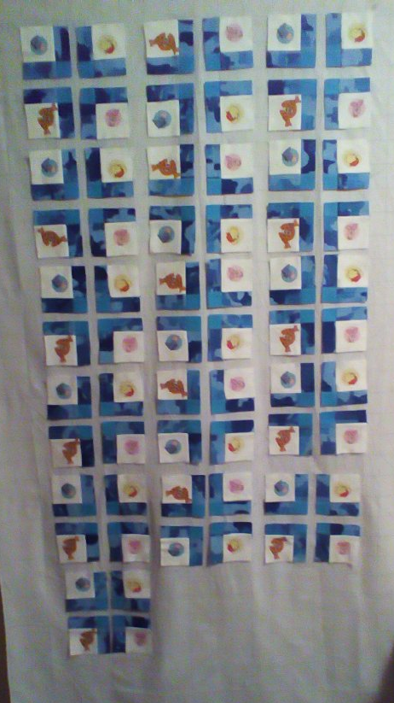
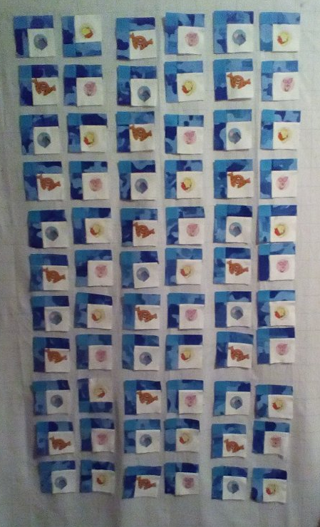
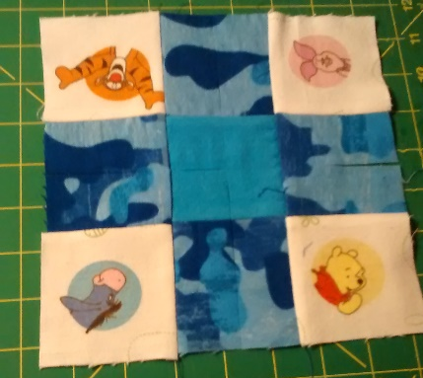
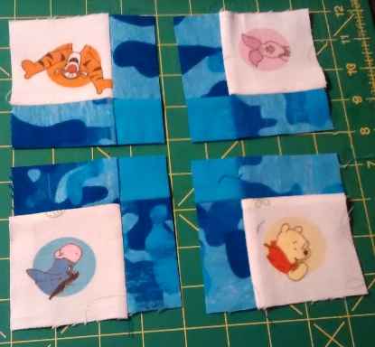
Step 9
Cut The 9-Patch Squares
Cut all 9-patch squares down the center vertically and horizontally.
Place on Layout board
Flip all squares so that the Solid is in the left corner.
Lay the Tigger square next to the Winnie the Pooh square, then put the Piglet square next to Tigger Square
Cut the Last Partial 9 patch and put Eeyore square next to Piglet and Pooh Next to Eeyore. (Solids should be in Left corner).
Verify that all characters are upright
*If you do have an error of on one of the squares you can easily fix. Tear out the seam that was wrong turn the character square so that it faces upright and make sure to reattach it so that the Solid squares is in the upper left corner.
B. Place on Layout board
C. Flip all squares so that the solid is in left corner.
D. Lay the Tigger Square next to Pooh Square on the bottom, lay Piglet Square next to Tigger. Cut and Place the final two squares from the partial 9-Patch with Eeyore first and Pooh last.
A. Cut all 9-patch squares vertically and horizontally

Slide 12
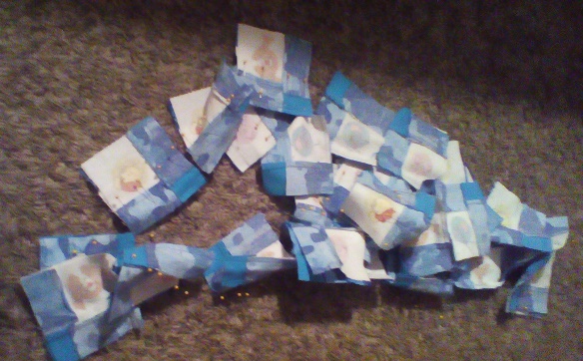
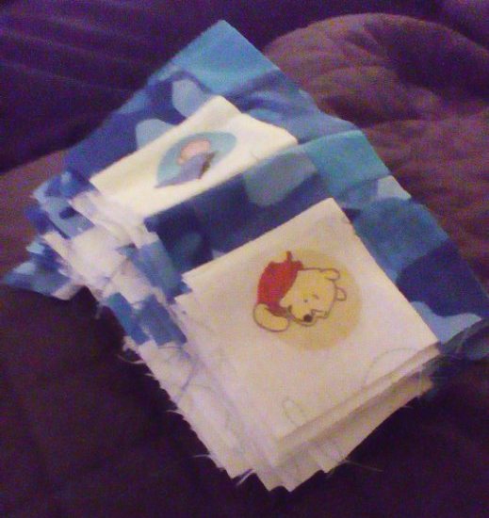
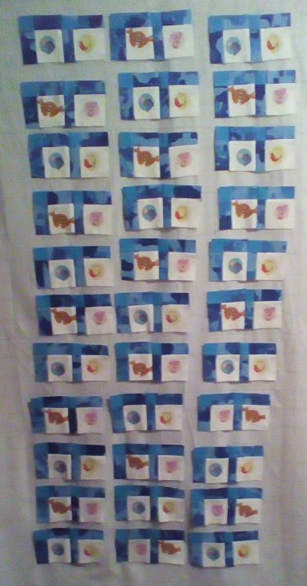
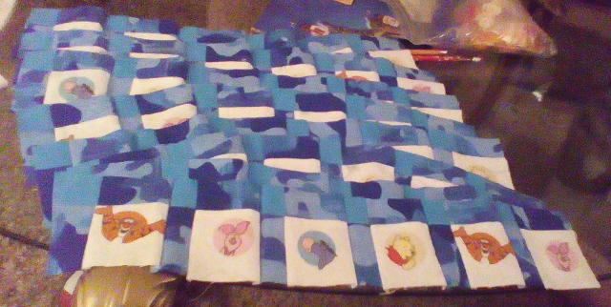
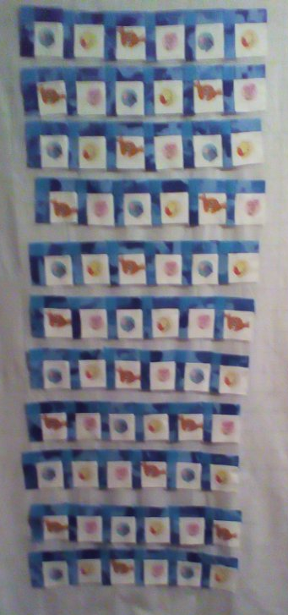
Step 10
Assembly of Rows
Carefully pin squares 1 and 2, 3 and 4, 5 and 6 of each row. Making sure to match up seams.
Sew all of these in a chain.
Cut apart chain making sure the 1st square set is on bottom so when you flip them it is first again.
Carefully pin 1st square set with 2nd square set matching seams, and 2nd square set with 3rd square set of each row matching seams.
A. Carefully pin squares 1 and 2, 3 and 4 and 5 and 6 of each row. Matching up seams.
B. Sew all these in a chain.
C. My 1st and 2nd, 3rd and 4th, and 5th and 6th sets. After I flipped my pile so left-top row was on top.
D. All the finished rows. These are not in correct order but I easily could remember which was top.
D. This is how it looks on the layout board.
----------→
C. Layout sets in correct order. Carefully Pin 1st square set to 2nd square set, and 2nd square set with third. Matching seams up.

Slide 13
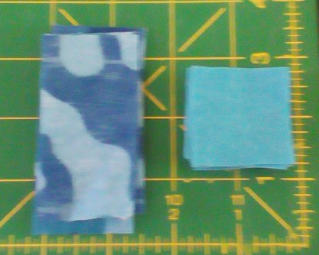
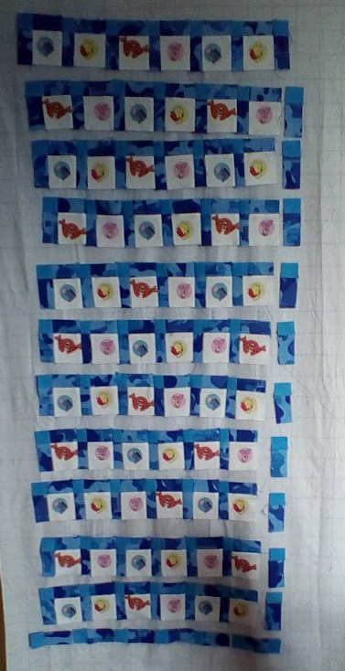
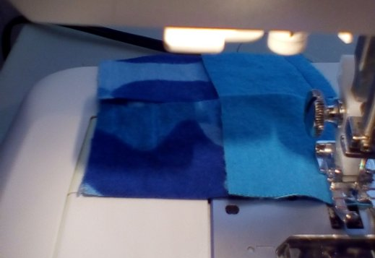
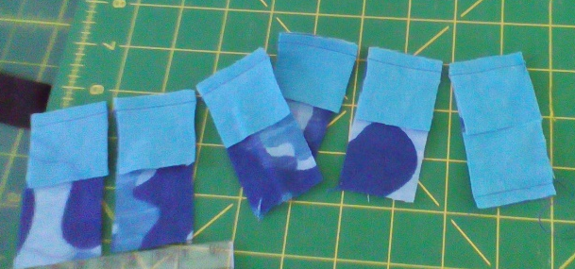
Step 11
Creating the Right Sashing
The next 3 slides show the making of the right and bottom sashing.
Line up the solid squares with the camouflage squares
Sew the right side of solid to the left side of camouflage
Cut apart the chain.
Press towards the solid squares.
Lay the Right sashing on the layout board with the solid at the top and the camouflage on bottom
Line up solid and camouflage so the blue is on top
B. Sew right side of solid to left side of camouflage.
E. Lay the right sashing on the layout board with the solid at top and the camouflage on the bottom. Should be vertical.
C. Cut apart the chain.
D. Press squares toward the solid color.

Slide 14
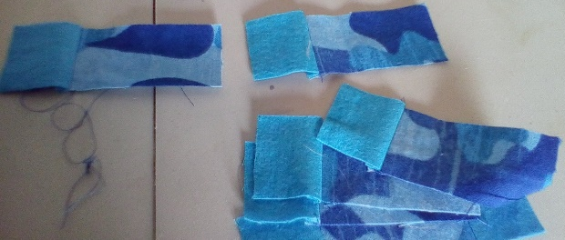
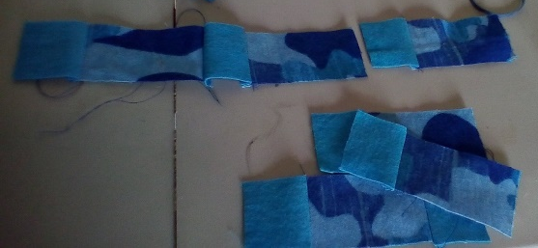
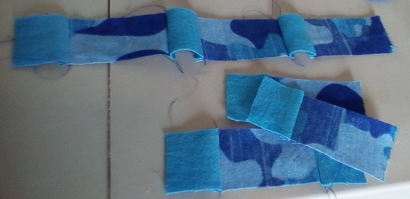
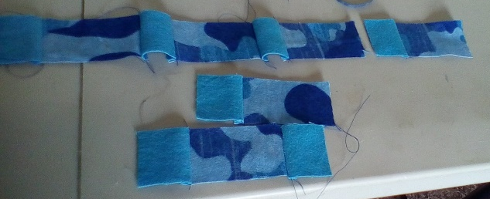
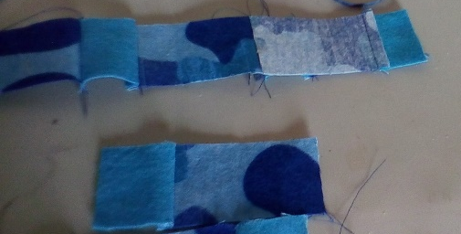
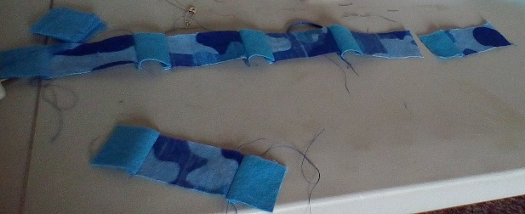
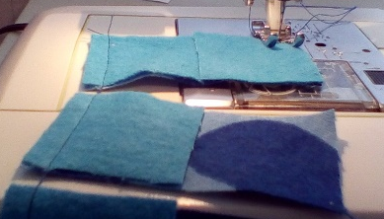
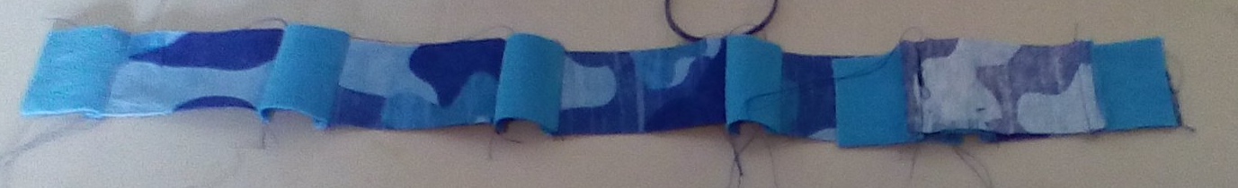
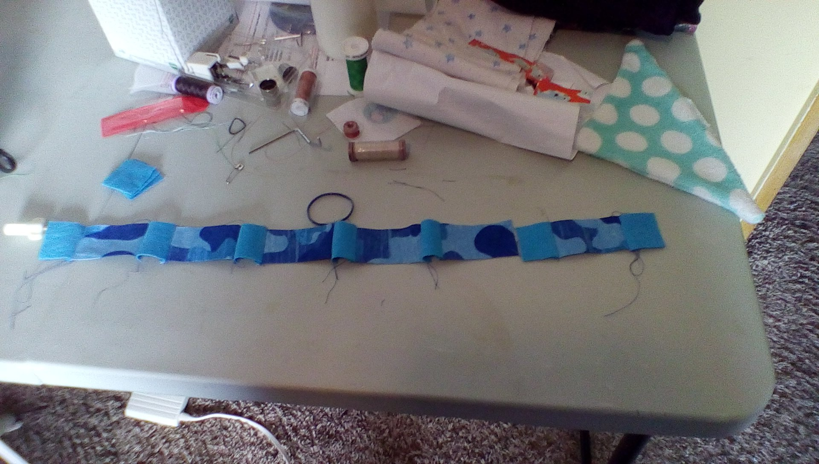
Step 11-2
Creating the Bottom Sashing
C. On the left are the steps to sewing the bottom row together.
Sew the Solid blues to the left of the camouflage strips
Attach a solid blue to the last strip set on the right
Sew the strip sets together so they make long bottom row.
Sew the solid blue to the left of the camouflage strips.
Attach a solid blue to the right side of the last strip set.

Slide 15
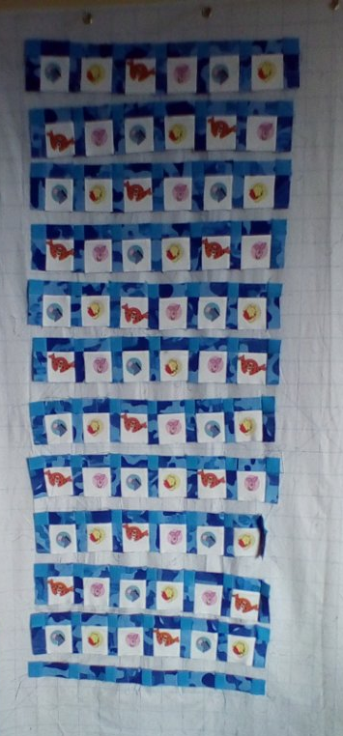
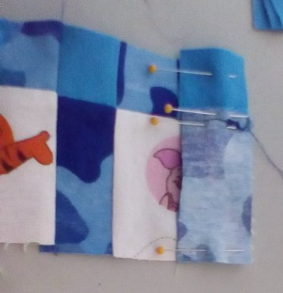
Step 11-3
Adding on Right Sashing
Match up the seams and pin the 1st row to the right sashing. Continue with all rows.
Place each row back on the layout board when you have added the right side sashing.
A. Match up seams and pin the right sashing to the right side of row.
B. Place the rows back on the layout board.

Slide 16
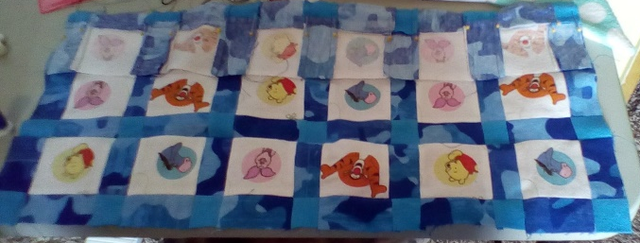
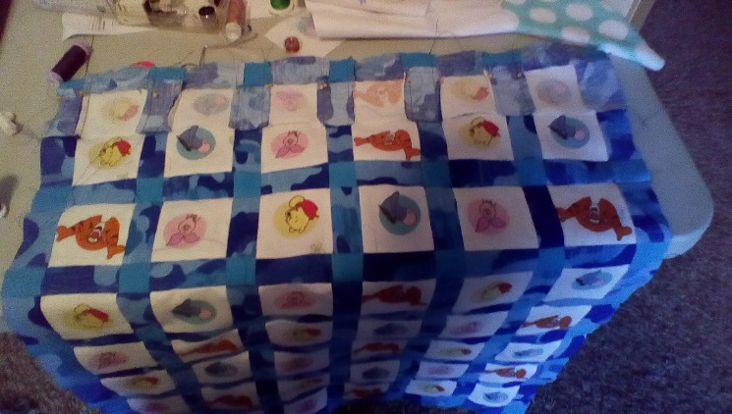







Step 12
Sewing the Rows
Pin carefully. Make sure to match up the seams. Sew the bottom of row 1 to the top of row 2.
Pin carefully. Make sure to match up the seams. Sew the bottom of row 2 to the top of row 3.
Pin row the bottom of row 3 to the top of row 4, being careful to match seams. Sew rows together.
Pin row the bottom of row 4 to the top of row 5, being careful to match seams. Sew rows together.
E. Pin row the bottom of row 5 to the top of row 6, being careful to match seams. Sew rows together.
F. Pin row the bottom of row 6 to the top of row 7, being careful to match seams. Sew rows together.
G. Pin row the bottom of row 8 to the top of row 9, being careful to match seams. Sew rows together.
H. Pin row the bottom of row 9 to the top of row 10, being careful to match seams. Sew rows together.
C. Pin row the bottom of row 3 to the top of row 4, being careful to match seams. Sew rows together.
G. Pin row the bottom of row 8 to the top of row 9, being careful to match seams. Sew rows together.
D. Pin row the bottom of row to the top of row 5, being careful to match seams. Sew rows together.
H. Pin row the bottom of row 9 to the top of row 10, being careful to match seams. Sew rows together.
E. Pin row the bottom of row 5 to the top of row 6, being careful to match seams. Sew rows together.
Pin carefully. Make sure to match up the seams. Sew the bottom of row 1 to the top of row 2.
I. Pin row the bottom of row 10 to the top of row 11, being careful to match seams. Sew rows together.
B. Pin carefully. Make sure to match up the seams. Sew the bottom of row 2 to the top of row 3.
F. Pin row the bottom of row 6 to the top of row 7, being careful to match seams. Sew rows together.

Slide 17

Step 12
Sewing the Rows
J. Pin row the bottom of row 10 to the top of row 11, being careful to match seams. Sew rows together.
J. Pin row the bottom of row 10 to the top of row 11, being careful to match seams. Sew rows together.

Slide 18
Step 12
Sewing the Rows
J. Pin row the bottom of row 10 to the top of row 11, being careful to match seams. Sew rows together.
J. Pin row the bottom of row 10 to the top of row 11, being careful to match seams. Sew rows together.

Slide 19



Step 13
Sewing the Borders
Cut 5 – 4” strips from border material
Angle cut 3 ends.
Sew 3 strips together
Measure the sides of the quilt
Cut the strips to the length of the sides
Pin the strips to left and right sides
Press the borders down.
Measure the top and bottom of quilt (including borders)
Cut the top and bottom borders strips
Pin down the top and bottom borders
Sew the top and bottom border strips on
Press the quilt
A. Cut 5 – 4” strips B. Angle Cut strips
C. Sew 3 strips together
D. Measure the sides of the quilt
E. Cut the strips to the length of the sides
F. Pin the strips to left and right sides
G Press the borders down.
H. Measure the top and bottom of quilt (including borders)
I. Cut the top and bottom borders strips
J. Pin down the top and bottom borders
K. Sew the top and bottom border strips on
L. Press the quilt

Slide 20
Step 14
Assemble the back, batting and top
Lay down the Winnie the Pooh Fleece back
Lay down cotton batting
Lay down the Winnie the Pooh Quilt top
Pin in each square
Put a stay stitch for each pin
When all stitches are in, remove all pins except border pins

Slide 21
Step 15
Quilting the baby blanket
Start in Row 5 between Tigger and Piglet quilt a line around center sash piece (camouflage rectangle)
Sew around Tigger with free motion quilt tool
Sew around Piglet with free motion quilt tool
Sew around Solid squares above and below the center sashing
Sew sashing above and below quilted Tigger
Sew sashing above and below quilted Piglet
Sew center sashing below and above previously sewn ones
Sew Eeyore above and below the sewn sashings
Sew Winnie the Pooh above and below.
Continue to work out from center in this same fashion until you have only 2 rows around the whole quilt left
The sew the next row around the quilt until all inner blocks have been quilted
Use a star stencil to make a star pattern border around the quilt

Slide 22
Step 16
Binding the Blanket
Trim the edges of the blanket top and bottom
Cut four-2 inch strips
Angle cut the four strips
Sew the four strips together
Press the angles down.
Pin the right side facing the right side of quilt, leaving a 6” lead and 6” following tail.
Measure the lead and following tails and sew together at an angle.
Pin down the newly sewn area.
With the walking foot, sew down the binding from the top of the quilt
Press the binding towards edge of quilt. Flip over the binding and press a ¼” fold. (Be careful to not touch the fleece with the hot iron).
Hand sew down the binding to the back using a blind stitch.

